Slide 1

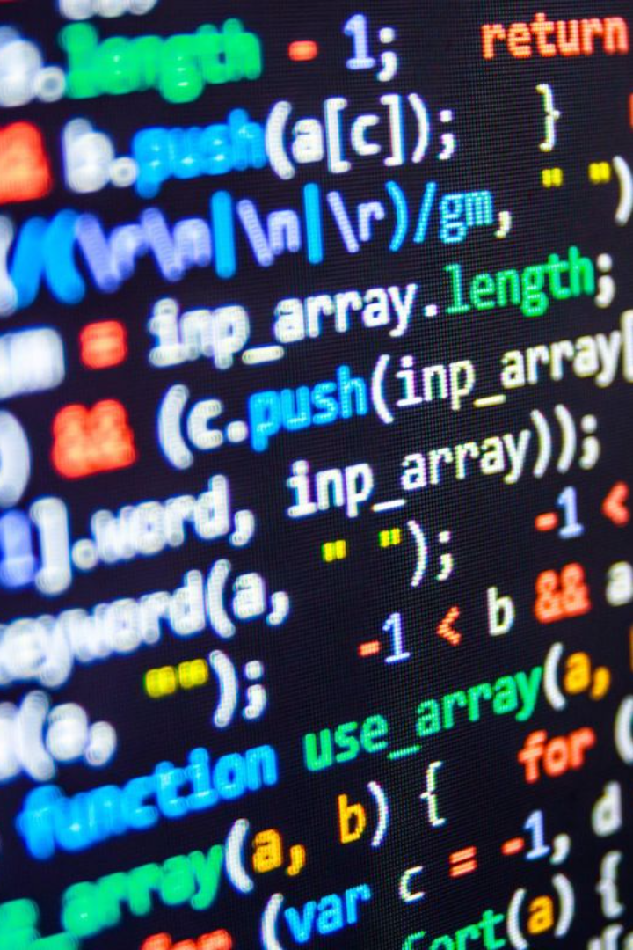
Introduction to Characters and Strings in C Programming
In this presentation, we will explore the importance of characters and strings in programming. We'll cover string literals in C language and learn about various string manipulation methods.

Slide 2
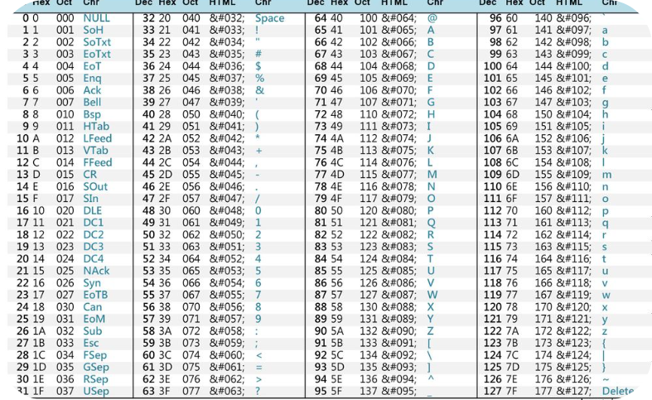
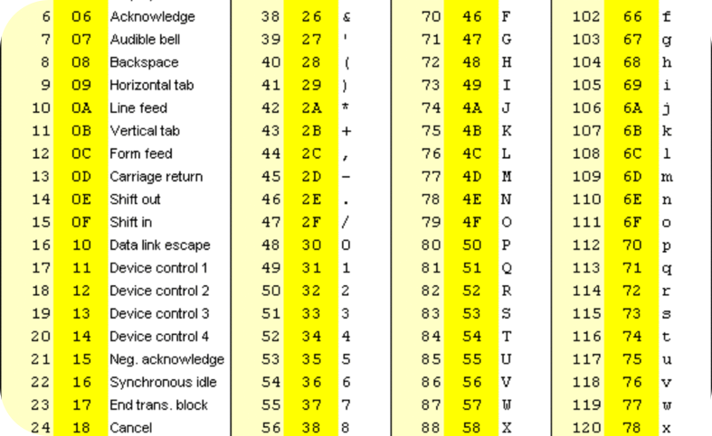
ASCII Table
ASCII Functions
Introduction to ASCII table and its significance in C language.
Examples of using ASCII functions in C programming.
ASCII Table and Its Functions

Slide 3

Understanding Strings in C
1
What is a string in C?
2
Declaring and Initializing Strings
A string is an array of characters that terminates with a null character ('\0'). It represents a sequence of characters.
Learn how to declare and initialize strings in C, including methods like assigning individual characters or using string literals.
3
Accessing Individual Characters
Discover different techniques to access and manipulate individual characters within a string using indexing and pointers.

Slide 4

String Literals in C Language
1
Definition 📚
2
Usage 💼
3
Examples 💡
String literals are sequences of characters enclosed in double quotes.
String literals are used for storing and manipulating text data in C programming.
char name[] = "John Doe";
char message[] = "Hello, World!";

Slide 5
Manipulating Strings Like a Pro
1
Concatenation
Combine multiple strings to create a new string using the strcat() function. Examples will showcase useful real-world scenarios.
2
Comparing Strings
Compare strings for equality, alphabetical order, or collation using the strcmp() function. Discover its practical applications.
3
Copying Strings
Learn how to duplicate a string to another using the strcpy() function, and explore its use cases and potential pitfalls.
4
Searching Within a String
Search for a specific character or substring within a string using powerful functions like strchr() and strstr(). Practical examples included.

Slide 6

Comparing Strings
1
Compare Method
Compare strings in C using strcmp function. Returns 0 if equal.
2
Example 1
strcmp("cat", "cat") ➡️ Returns 0
3
Example 2
strcmp("cat", "dog") ➡️ Returns a value greater than 0

Slide 7
More String Manipulation Methods
Upper Method
Lower Method
Reverse Method
Convert strings to uppercase in C using the toupper function.
Convert strings to lowercase in C using the tolower function.
Reverse strings in C using a loop or recursion.

Slide 8
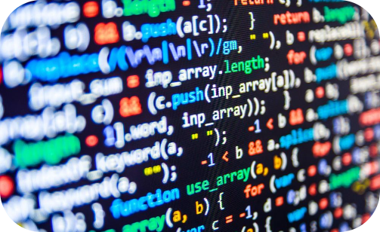
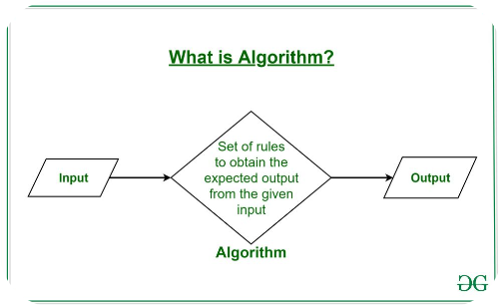

Incorporating String Manipulation in Real Projects
Enhancing User Input Processing
Implementing String Algorithms
Building Dynamic Web Applications
Discover how to leverage string manipulation techniques to create robust user input handling systems in your projects.
Learn how to apply string manipulation algorithms to solve common problems in areas like text processing and data analysis.
See how mastering string manipulation can be instrumental in developing dynamic web applications with data processing and manipulation capabilities.

Slide 9

Why Are Characters and Strings Important?
Recap of String Manipulation Methods
Characters and strings are fundamental components of text-based programming and enable data manipulation.
We covered various string manipulation methods like read, length, upper, lower, reverse, and compare.
Encouragement to Explore Further
Continue practicing string manipulation in C programming to solidify your skills.
Conclusion

